Slide 1

Contoso Coffee
Case Study 0

Slide 2

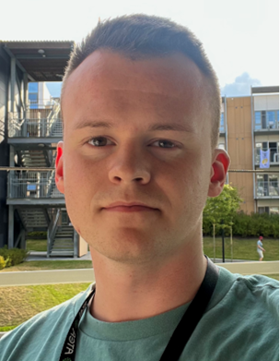
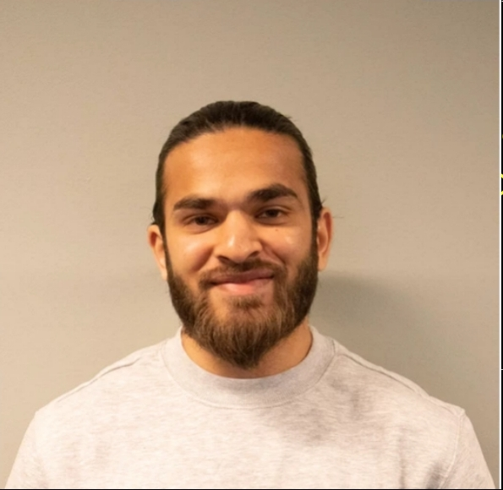







Group members
Hamzeh Alsheikho
Runar Gullaksen​
Adrees Ahmed
SecOps consultant, ITOM
Junior Consultant​
Junior Cloud Engineer
Notes:
Hamzeh:
Introduction of the Contoso Coffee
What we will cover
Customers requirements
Runar:
Work as a junior consultant for Atea in Bergen
Design and creation of AD for the tenant
As well as hosting solutions for the website with use of ACI and ACR
Storage Account
Adrees:
Traffic Manager – How the website will remain redundant and load-balanced

Slide 3

Contoso Coffee
Contoso Coffee is a small coffee house that will opening soon
London and New York
They are looking for a cloud hosted solution for their website and data storage.

Slide 4
Task Outline Requirements
Cloud hosted-solution for their website
Difficulty levels:
Level 1 – Host the website with use of Web App
Level 2 – Build a docker container and deploy it through Web App
Level 3 - Deploy an ACI solution from ACR.
Cost must be kept to a minimum
Give admin access for users in the tenant
Notes:
Cost:
We must consider that the cost must be kept to a minimum

Slide 5




Our plan
Designing an AD
Container Registry & Container Instance
Build a docker image
Storage Account
Implement Traffic Manager
Redundancy
Load-Balancing
Azure Resource Manager (ARM)

Slide 6
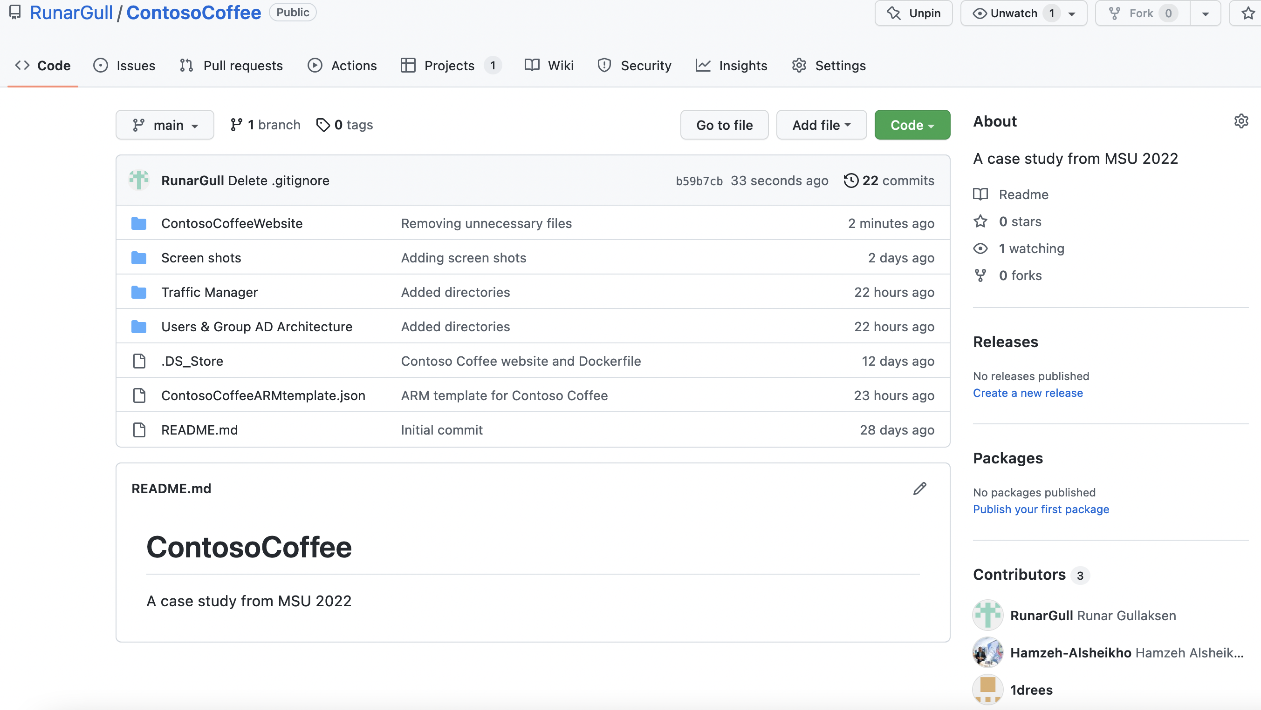
Collaboration on GitHub
Notes:
Jeg skal bytte ut bildet litt senere Hamzeh. Vi må få med bilde av alle de andre mappene på GitHub

Slide 7
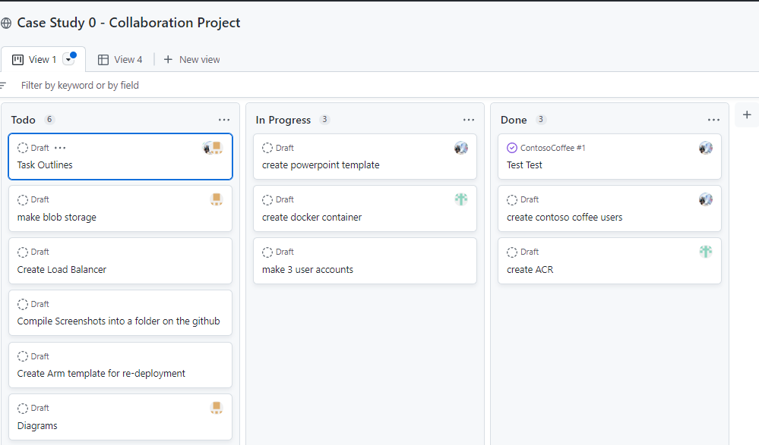
GitHub Projects – Collaboration Overview

Slide 8
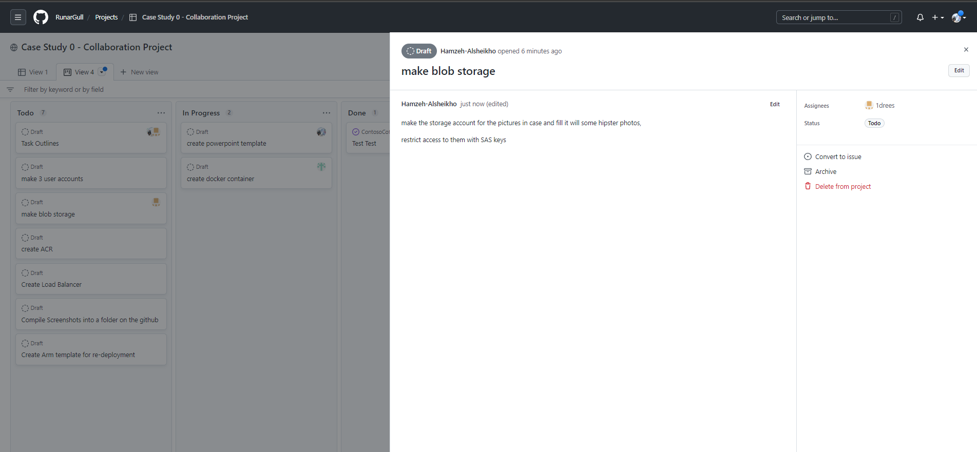
GitHub Projects – Collaboration Overview

Slide 9
Architectural Deisgn of Azure Active Directory

Slide 10
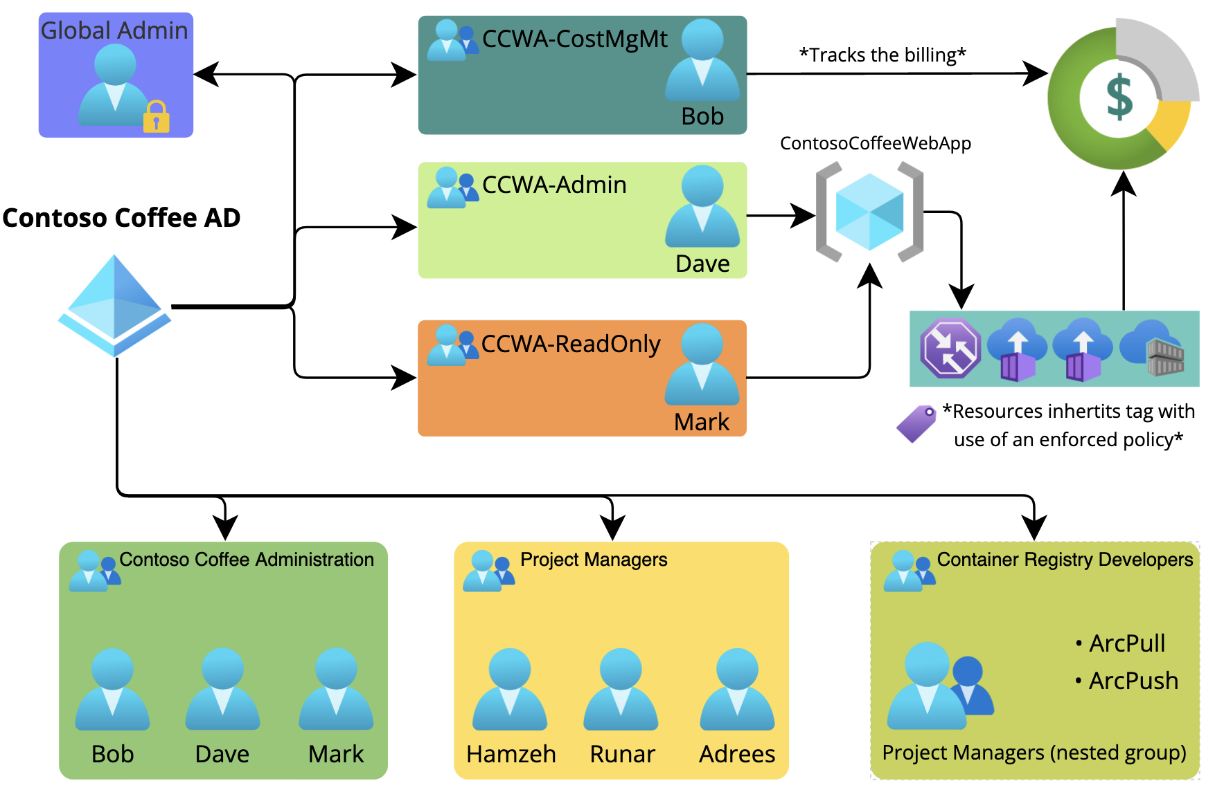
Users & Groups Architecture design
Notes:
USERS & GROUPS:
* Designed in a way that makes future administration easier and strengthen security based on LPP
Placed into groups based on their department & roles.
Project Managers ⫸ Container Registry Developers ⫸ ArcPull & ArcPush
Same thing as the other security groups
RESOURCE GROUP:
Resources related to the Website – Keep it structured
Assign your own custom policy (TAG) – Automate simple admin tasks.
Track billing of resources associated with the website
* And the reason why is that we can easily administrate the resources within the same resource group and as well automate simple tasks like applying an enforced policy that will make the resources inherit the resource group tag.
* Which then makes it possible for Bob to track the billing of every resources that is associated with the common inherited tag.
* And as well – Dave is placed into a group that has admin access to the resource group, and Mark is placed to a group that has the ReadOnly permission.
* By using groups like in this scenario – Makes future administration easier. Like assigning new users into the same group.
* To make future administration easier – For instance, Bob can then assign new users
*
* The reason why we placed them into the Developer group, was to assign the users within the Manager group sufficient permissions to push & pull docker images to the container registry.
GLOBAL ADMIN:
We decided to create a standalone Global Admin account for the Contoso Coffee Tenant by separating it from the users. This is due to security reasons – and mainly because of Least Privilege Principle. There is no reason for an active user to have an unnecessary permissions to everything in Azure.
Instead, the user account is given the sufficient permission that is needed to do their work in Azure.
* The Global Admin account will remain secured with additional security features like Multi-Factor Authentication and Conditional-Access Control.

Slide 11
Creating Docker Container Instances

Slide 12
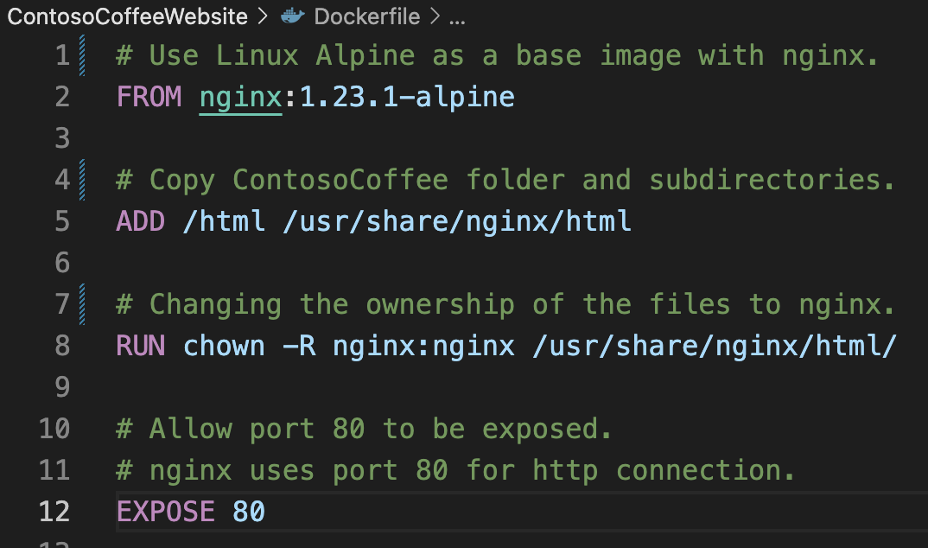
Dockerfile
Docker Engine
Base image
Copy (add)
Ownership
Expose port 80
Notes:
DOCKER :
Virtualization engine tool that is used to run containerized environment with a base image.
In comparison to a traditional VMs – It is known its effectiveness in regards to performance and scalability
Dockerfile – Set of instructions for the docker to build an nginx image with Linux Alpine.
HTML files is extracted into the image, and set to a nginx ownership.
Lastly – allows HTTP to be exposed.
Real life – HTTPS (443)

Slide 13

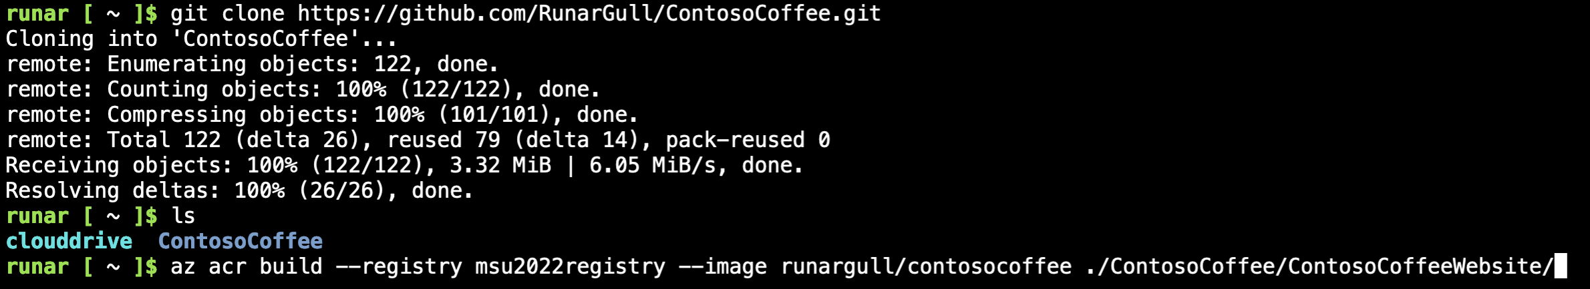
Docker Image Build
git clone (GitHub)
Dockerfile
Azure Cloud Shell
Azure Container Registry (ACR)
Notes:
In order to build – Git clone repository
Normally Docker Hub
Builds locally in the cloud shell
Azure Container Registry - Internal application development

Slide 14
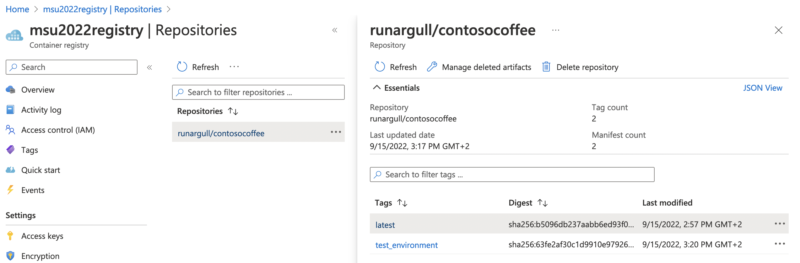
Azure Container Registry (ACR)
Notes:
In this case
Different Tags – Same Repository
Developer Team

Slide 15
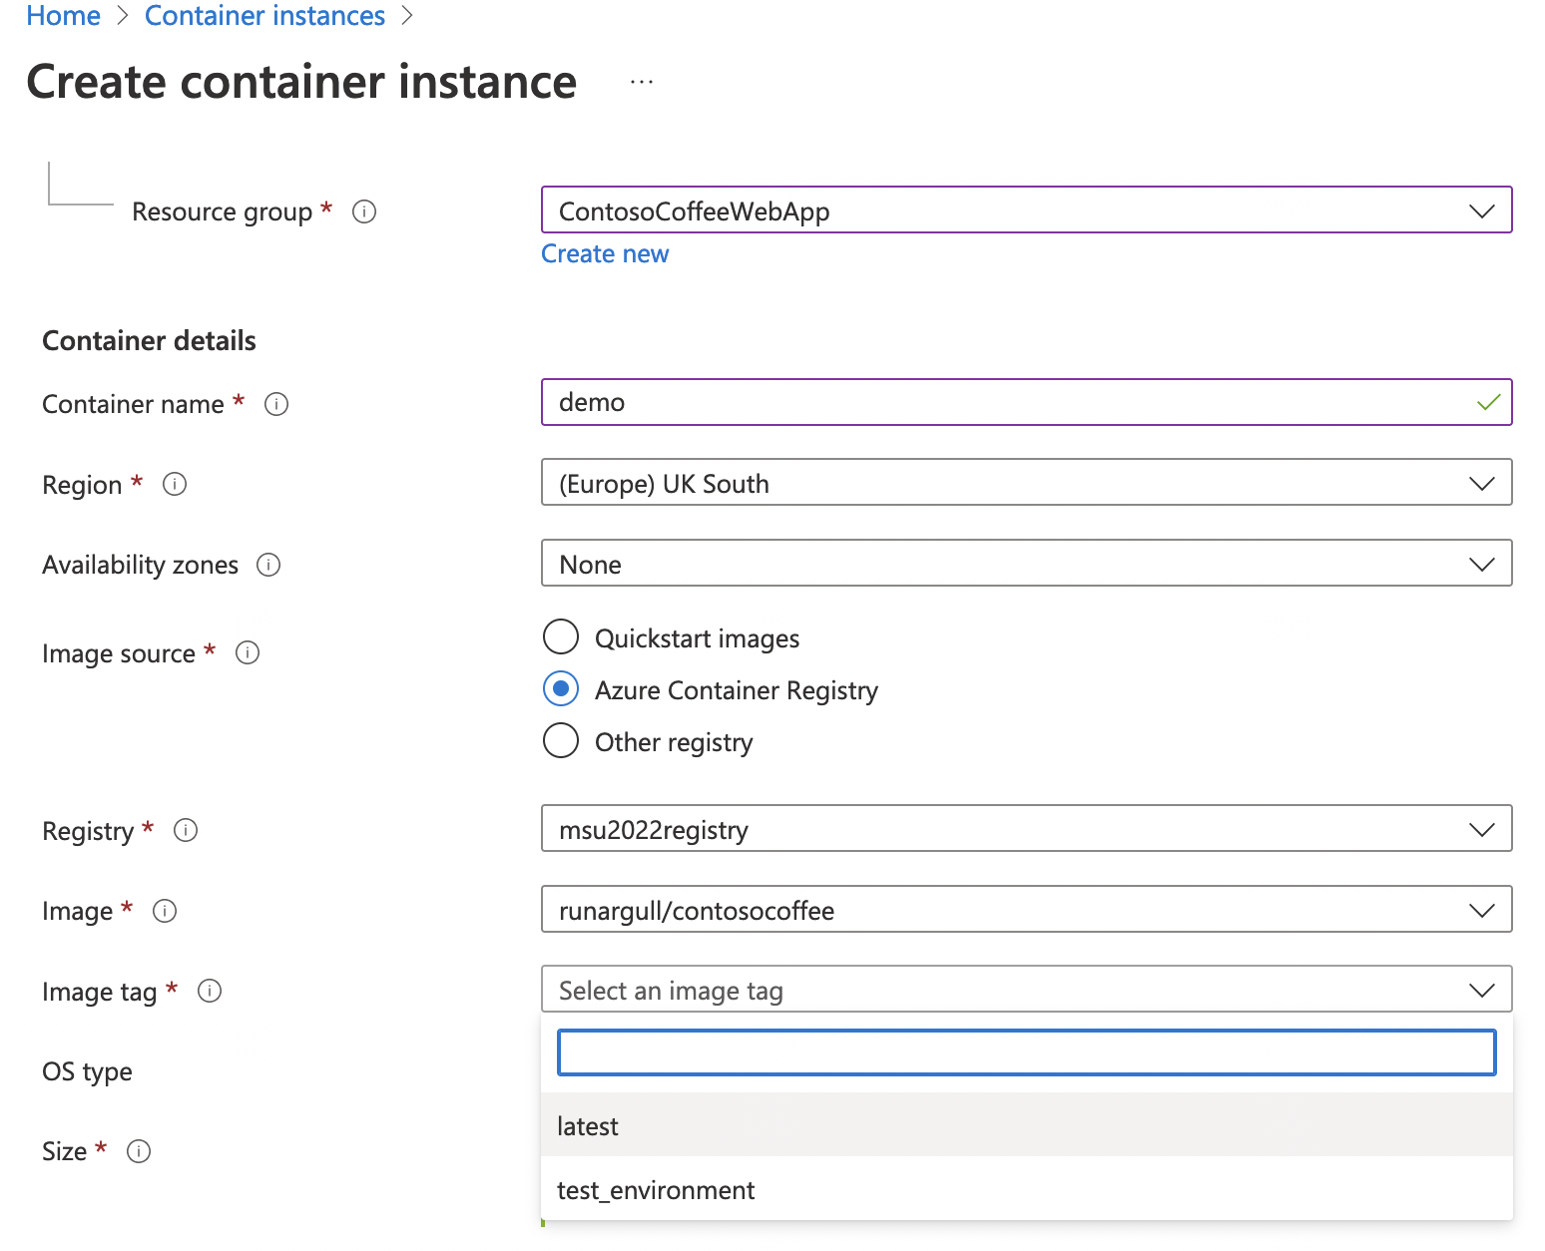
Azure Container Instance (ACI)
Notes:
As shown
Create a Container Instance by pulling
Choose the Tag

Slide 16
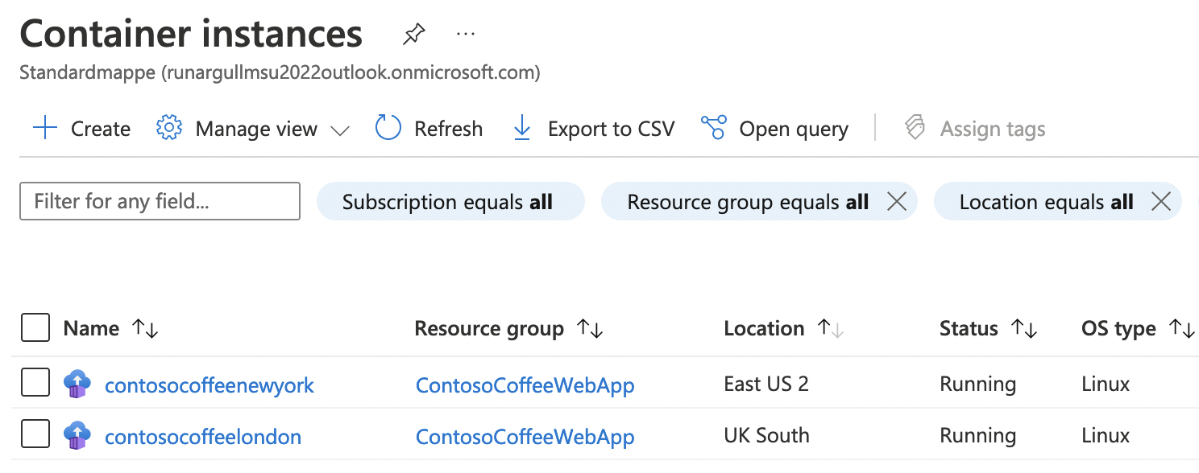
Deployed Container Instances
Notes:
As of now
UK South & New York

Slide 17
Creating A Storage Account

Slide 18

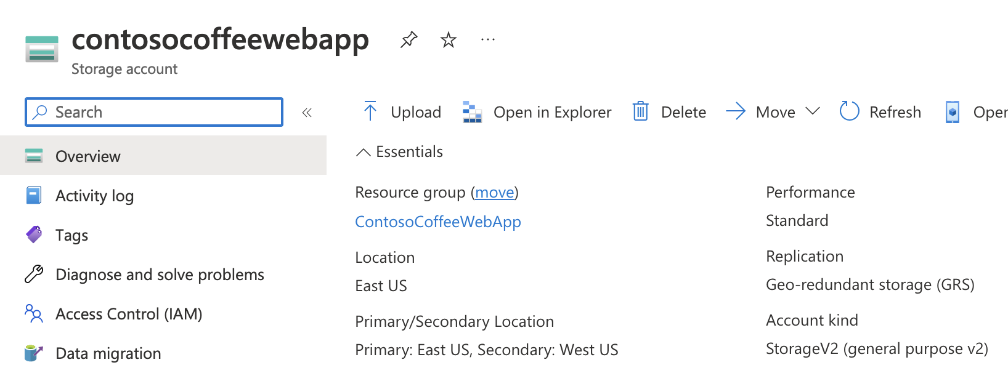
Storage Account
General Purpose V2
Hot Access
Geo-Redundant

Slide 19
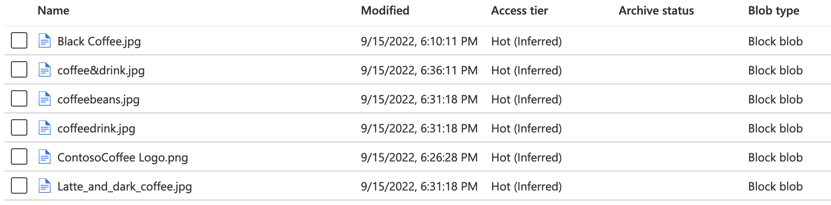
Capabilities
Shared-Access-Signature (SAS)
Shared across instances
Lifecycle Management (cost management)

Slide 20
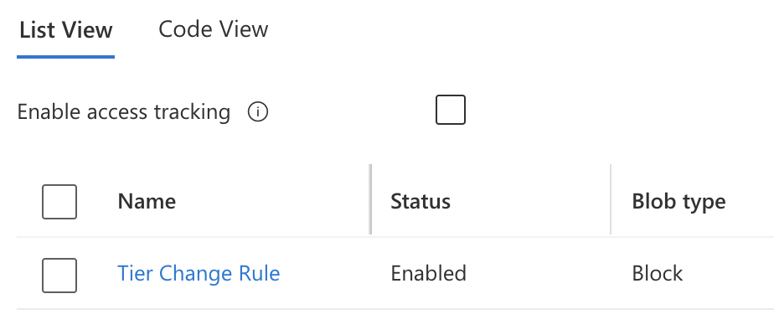
Licecycle Management
7 Days
Hot -> Cool
Cost saving

Slide 21
Implementation of Traffic Manager

Slide 22
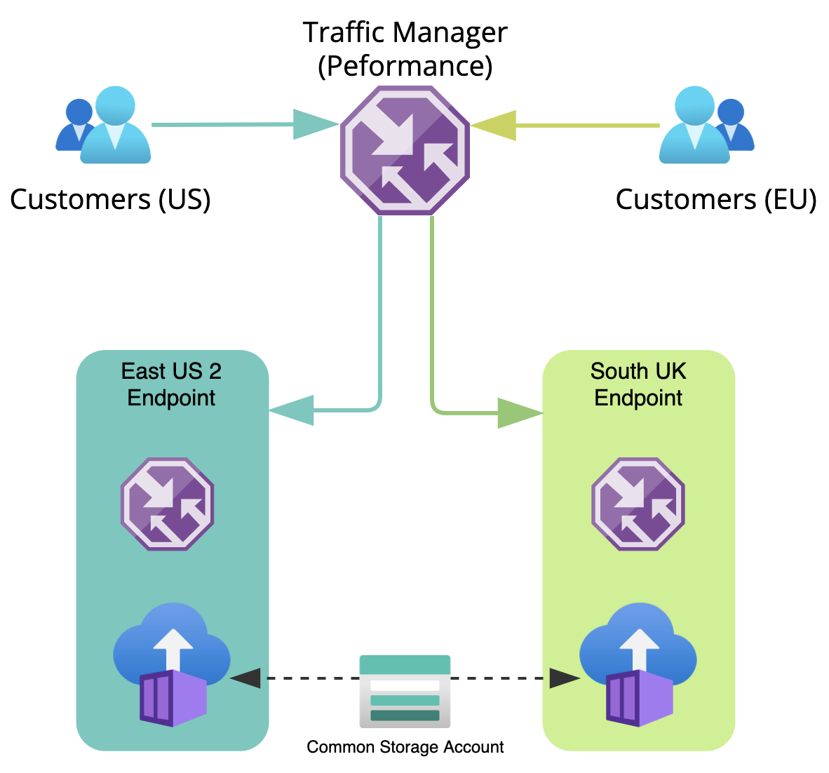
Notes:
First of all, Traffic Manager is a Global Azure service that runs in layer 7, used to redirect users to the nearest external endpoint. This method is known as a performance based routing. Which means that the traffic manager will redirect users to another endpoint if the closest endpoint is unavailable.
The Container Instances are connected to the Traffic Manager with an associated Fully Qualified Domain Name. The FQDN remains static and won't change, but the public IP address on the other hand is dynamic and will change. We encountered this kind of issue when we used the public IP address to the external endpoints, which is why we changed to the FQDN.
As shown in the illustration, the Container Instances uses a common storage account that will contain the images which will be displayed on the web site.

Slide 23
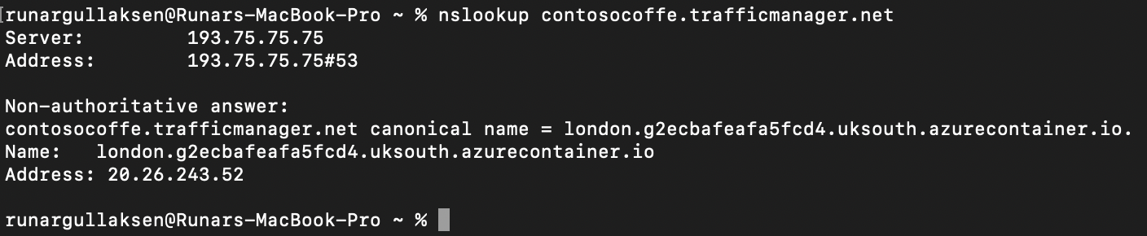
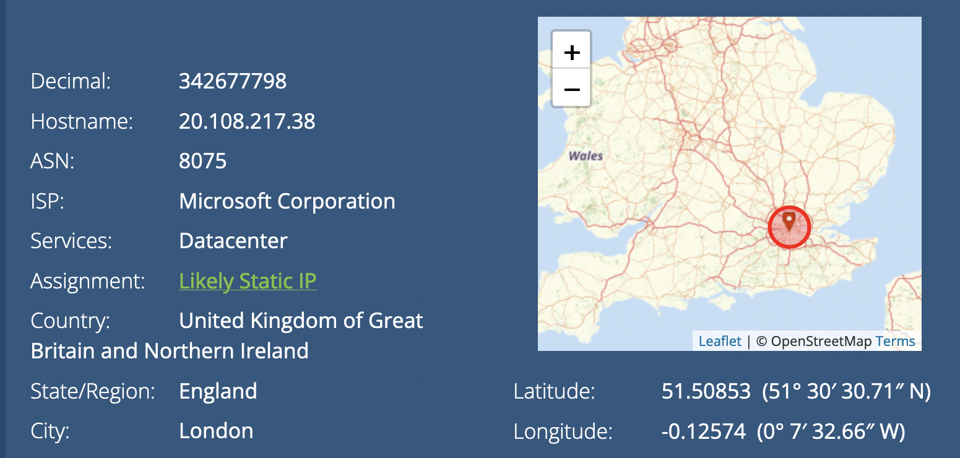
Notes:
* We used the nslookup command to gather the public IP address of the Container Instance, and got an address that originates from South UK

Slide 24
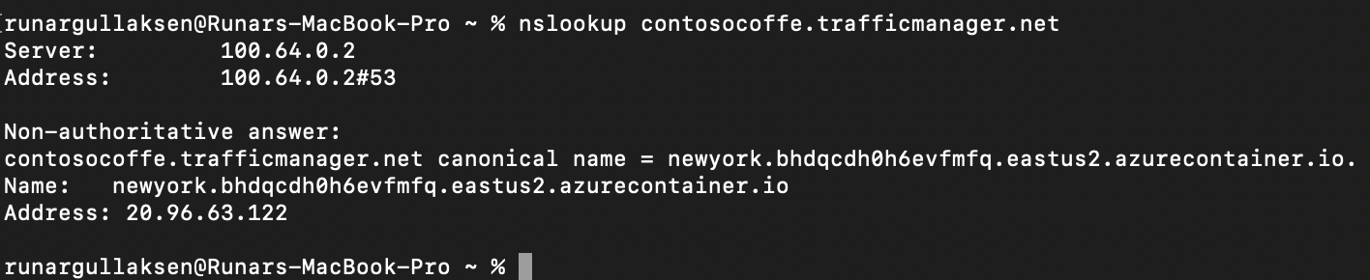
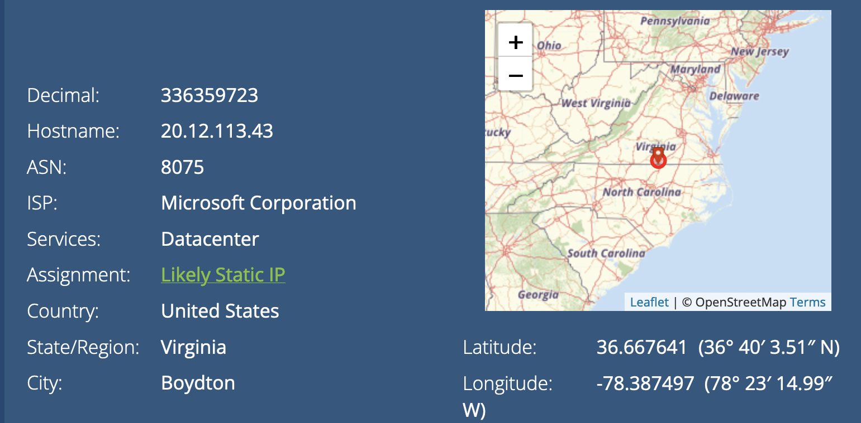
Connected via a NordVPN server in the US US*
Notes:
* Afterwards, we connected a client to a VPN server located in the US, and attempted to nslookup the website
* We then recieved an IP address that originates from the East US 2 region

Slide 25
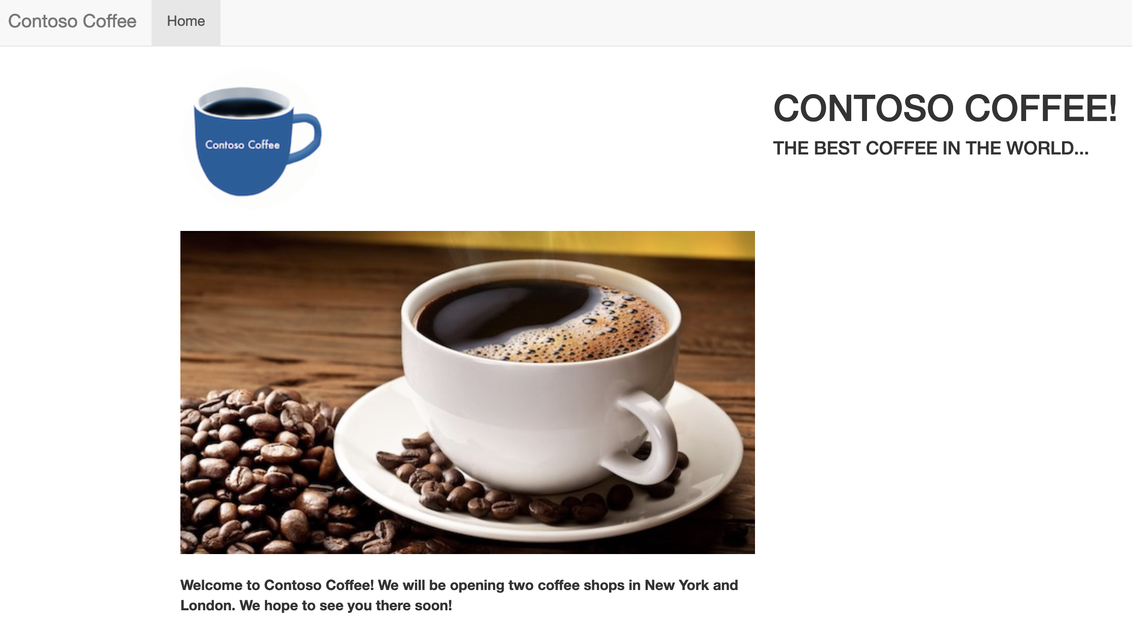
http://contosocoffe.trafficmanager.net

Slide 26
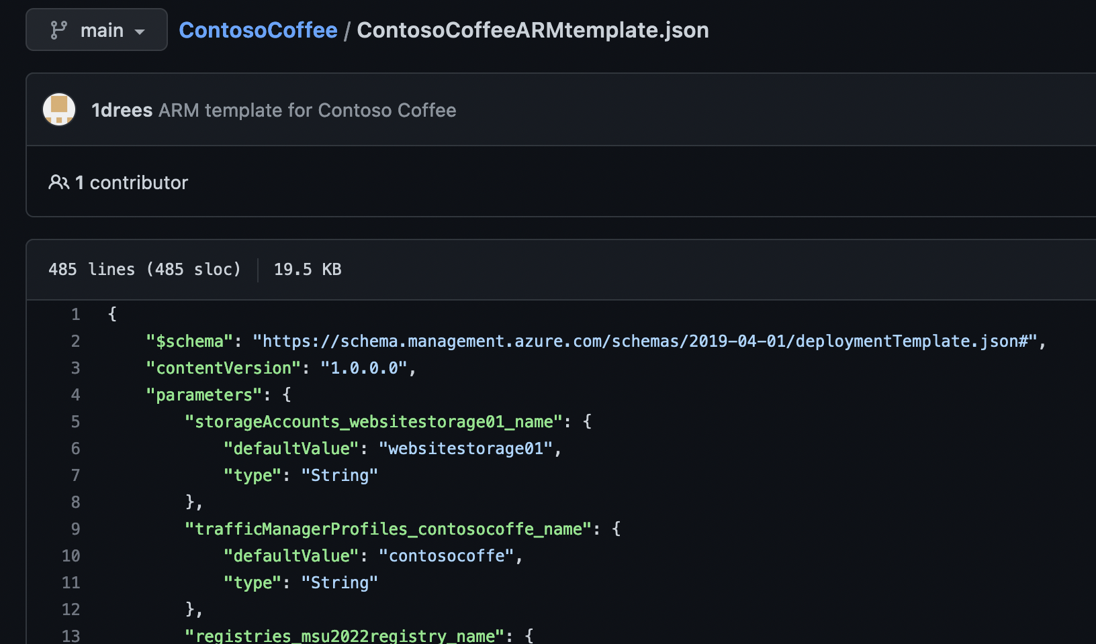

Slide 27
Recap Of The Presentation
Design of AD
Docker Image & Deployment
Storage Account
Possible Access Issue
Traffic Manager
Redundancy
Load-balancing
Notes:
The design of the active directory has been covered in regards to strengthen overall tnant security and to easen future administration
How Docker Images is built and deployed to the cloud with use of Container Registry and Instance.
How Storage Account is used and associated with the deployed website. * By previewing the stored images with use of Shared-Access-Signature tokens
As well as how the requested archiving rule could cause access issues to the stored images
How Traffic Manager provides the need of mantaining the rendundancy and load-balancing the traffic to the website

Slide 28

Q&A
Thank you

